Slide 1
Setting up the Development Environment

Slide 2
Install Python
https://www.python.org/downloads/

Slide 3
Install VS Code
We will be working with a more robust IDE named VS Code that has a rich set of features and sophisticated debugging capabilities
https://code.visualstudio.com/download

Slide 4


Set up your work environment for this course
Create a folder in your documents folder and name it AdvPython
This will serve as the parent folder for this course
All projects/folders we work with will be under this parent folder
In the AdvPython folder create a subfolder and name it IntroToVSCode
NOTE: Do not use cloud drives such as Box or OneDrive. Also make sure your file pathway does not have any spaces.
C:\Users\johnn\Box\MIS 4322 - ADVANCED PYTHON\IntroToVSCode
C:\Users\johnn\Documents\AdvPython\IntrotoVSCode

Slide 5

Walking through VS Code
File Explorer
Global Search
Source Control (Git)
Debugger
Extensions Marketplace

Slide 6
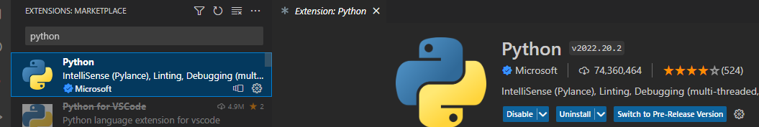
Install the Python Extension

Slide 7
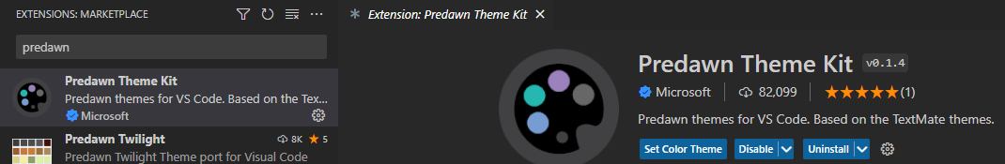
Install a color theme

Slide 8
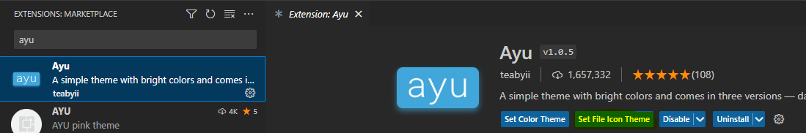
Install a File Icon Theme
From this theme we only want to set the File Icon Theme.

Slide 9
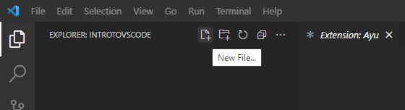
Add a new file to your project
Back in the file explorer tab, select add a new file and name it test.py

Slide 10
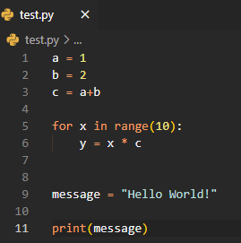
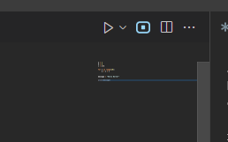
Write your first program in VS Code
Type in this code
Run the code

Slide 11
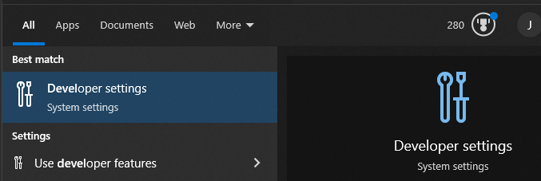
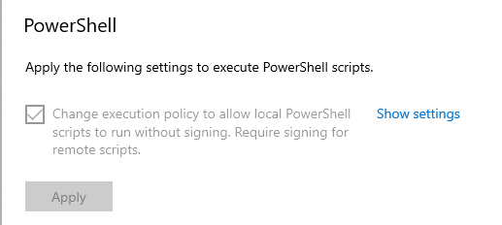

If you get a security error (windows)
Search for Developer Settings in the search bar in Windows
Scroll all the way to the bottom of the page and uncheck and then check the box under PowerShell

Slide 12


Alternatively
In the terminal window type:
Set-ExecutionPolicy -ExecutionPolicy Bypass
If that does not work
Set-ExecutionPolicy -ExecutionPolicy Bypass -Scope process

Slide 13
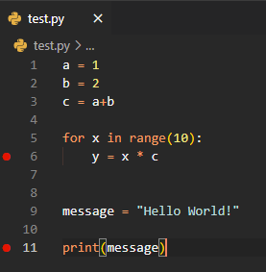
Using the Debugger
Put a breakpoint on line 6 and 11
Run the debugger
Use the Debug Console
y * 10
message.upper()
message.split()

Slide 14
Customizing VS Code
Open the settings file (JSON and not UI)
Add the following settings:
"workbench.settings.editor": "json"
"editor.formatOnSave": true
"editor.parameterHints" :false

Slide 15
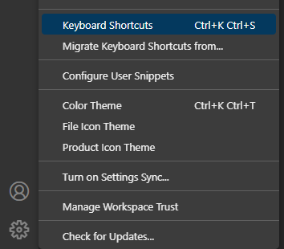
Keyboard Shortcuts
For Windows - File >> Preferences >> Keyboard Shortcuts
For Macs – Code >> Preferences >> Keyboard Shortcuts
Alternatively,
Go to the Manage Icon and select
Keyboard Shortcuts
Search for ‘Run Python File in
Terminal’

